Slide 1
Dunder Mifflin Database Systems
By: Raul Gutierrez
Aaron Caldwell
Michael Nguyen
Stephanie Delgado
Jonathan Escobedo

Slide 2
Dunder Mifflin Office Supplies
Dunder Mifflin Database systems is an organization in which office supplies are sold through algorithms, contacting sales representatives, and monthly sales are stored and called through programming classes known as Sales, Products, Clients, and Sales Representatives.

Slide 3
Roles
Raul Gutierrez – Sales Representatives designer/code developer
Aaron Caldwell – Products class designer/code developer
Michael Nguyen – Sales Menu & History designer/code developer
Stephanie Delgado - Client Information designer/code developer
Jonathan Escobedo – Project Presentation creator/designer

Slide 4
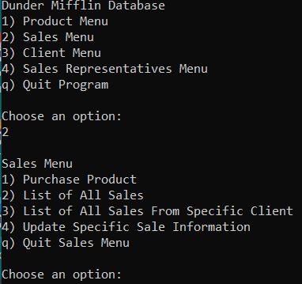
Main Menu
Shown here is the Main Menu for the Dunder Mifflin Database algorithm complete with a Product Menu, Sales Menu, Clients Menu, and Representative information.
The Quit function is also listed to exit the program.

Slide 5
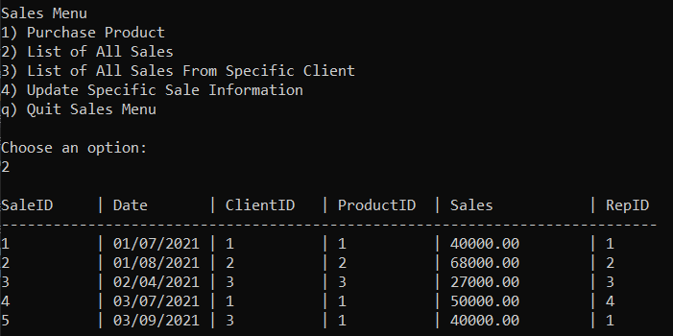
Sales Menu
Here is a list of all office supplies sales dates and total profits earned labeled with a SalesID, RepID, and ProductID for simplicity.

Slide 6
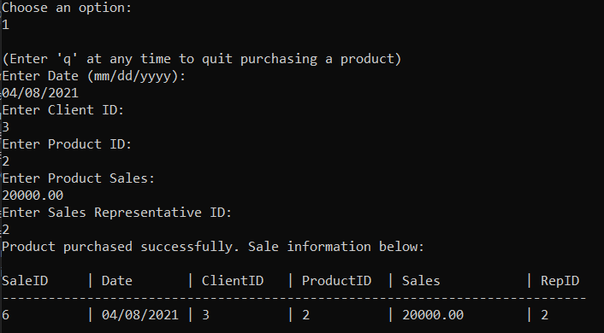
Sales Purchase
Here is a client entering information in order to purchase office supplies and the order is recorded in the Product Sales program with a profit of $20000.00.

Slide 7
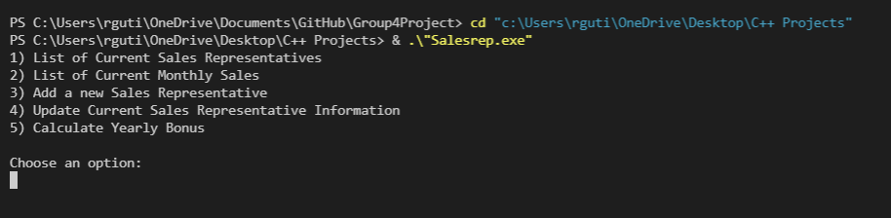
Sales algorithm structure
The algorithm first allocates a list of current Dunder Mifflin Sales Representatives as shown here and goes through a list of five numbered steps.

Slide 8
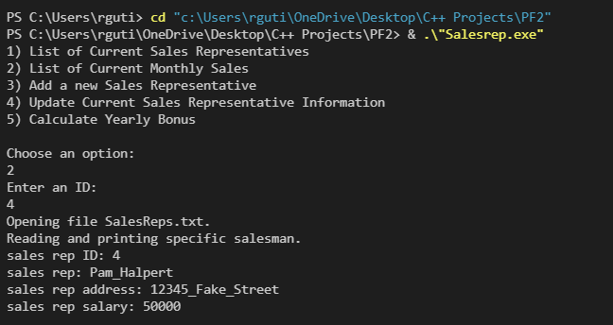
Monthly Sales locator
Shown here is the program searching for the total monthly sales count of Dunder Mifflin office supplies retailers. The program finds a representative and shows their address and annual salary through an integrated ID system.

Slide 9
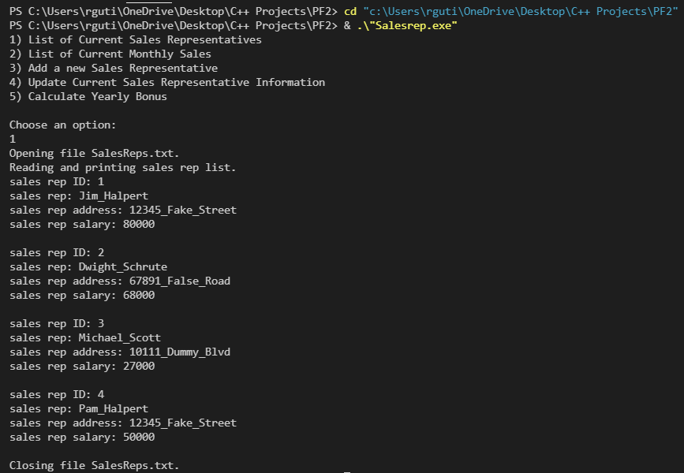
Current Sales Representatives
Here is an example of the Salesrep.exe algorithm listing all Sales Representatives information by extracting the SalesRep.txt file input to the program.

Slide 10
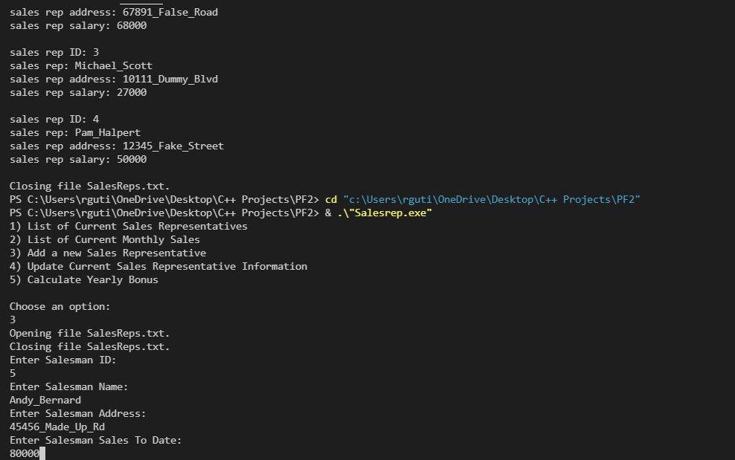
New Sales Representatives
Option 3 is shown being implemented by the algorithm to find new Sales Representatives for the benefit of Dunder Mifflin office supplies sales and to better the quality of business conducted.

Slide 11
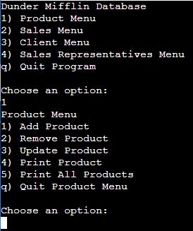
Product Menu
Here is the Product Menu for Dunder Mifflin Database Systems where the algorithm selects an option to add new products, release old stock, or print all given items available.

Slide 12
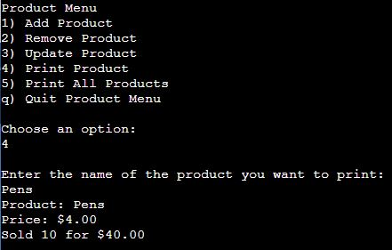
Products Purchased
The Products class selects an option from the numbered choices shown here and outputs the name of the product: Pens, price: $4.00, and quantity sold: Sold 10 for $40.00

Slide 13
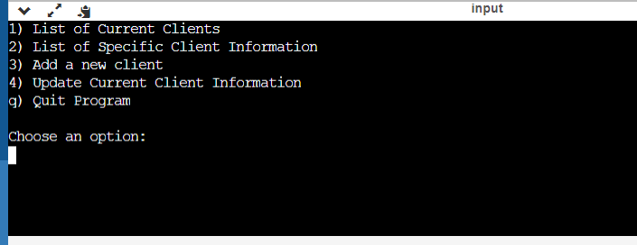
Clients Menu
Here is the Dunder Mifflin Database Clients Menu along with the options used by the algorithm to add and show client information.

Slide 14
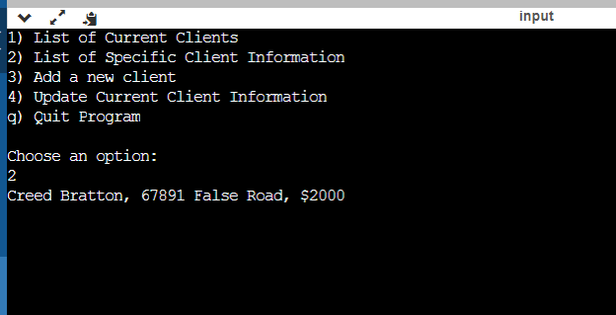
Client Information
Shown here is the Clients programming class compiling Option 2 to output the information of Creed Bratton along with his home address and money amount.

